Slide 1
WELCOME
1
DATE:17/05/2023

Slide 2

DR SIVANTHI ADITANAR COLLEGE OF ENGINEERING
TIRUCHENDUR – 628 215
ANNA UNIVERSITY :: CHENNAI 600 025
PROJECT TITLE – PADDY LEAF DISEASES DETECTION USING IMAGE PROCESSING
GUIDE - Dr. J JOSHUA BAPU, ME, PhD, MISTE
VIVA –VOCE EXAMINATION
PROJECT WORK ( EC 8811 )
BATCH – 8
STUDENT NAME REGISTER NUMBER
FAISAL ASLAM
MATHESH T
MUTHUVEL M
SURESH KUMAR C
950519106004 950519106015 950519106019 950519106034
2
DATE:17/05/2023

Slide 3
OUTLINE
ABSTRACT
INTRODUCTION
OBJECTIVE
METHODOLOGY
REQUIREMENTS
IMPLEMENTATION
RESULTS
CONCLUSION
FUTURE SCOPE
REFERENCE
3
DATE: 17/05/2023

Slide 4
ABSTRACT
In this project, represent a method for detecting paddy leaf disease using image processing techniques.
The proposed method involves capturing images of paddy leaves and processing them to identify the presence of disease.
The proposed method will be tested on a dataset of paddy leaf images, and the result show that it can accurately detect the presence of disease in paddy leaves.
4
DATE:17/05/2023

Slide 5
INTRODUCTION
Paddy leaf diseases have become a major threat to the quality and yield of rice crops. Early detection of paddy leaf diseases is crucial in preventing significant losses in crop yield and quality. Traditional methods of detecting paddy leaf diseases rely on manual inspection, which is time-consuming and prone to errors. In recent years, image processing techniques have emerged as a promising solution for the early detection of paddy leaf diseases. Image processing allows for the automated detection and diagnosis of paddy leaf diseases, which can significantly reduce the time and effort required for disease detection. The proposed method involves capturing images of paddy leaves using a digital camera, followed by image preprocessing, feature extraction, and classification. Image pre-processing involves various image enhancement techniques to improve the quality of the images, while feature extraction involves extracting relevant features from the preprocessed images.
5
DATE:17/05/2023

Slide 6
OBJECTIVE
To detect paddy leaf disease portion from image
To extract features of detected portion of leaf
To recognize detected portion of leaf through SVM (Support Vector Machine)
DATE:17/05/2023
6

Slide 7







METHODOLOGY
Image
Feature
Feature
Load image
Segmentation
Extraction
Selection
Result
Classification
SVM
DATE:17/05/2023
7

Slide 8
REQUIREMENTS
HARDWARE REQUIREMENTS:
LAPTOP OR PC
RAM : Minimum 8GB
CORE : i3,i5,i7
DISKSPACE : Minimum 128GB Memory
OS : Windows 10, 11 or linux
SOFTWARE REQUIREMENTS:
MATLAB R2018a or Higher Version
8
DATE:17/05/2023

Slide 9
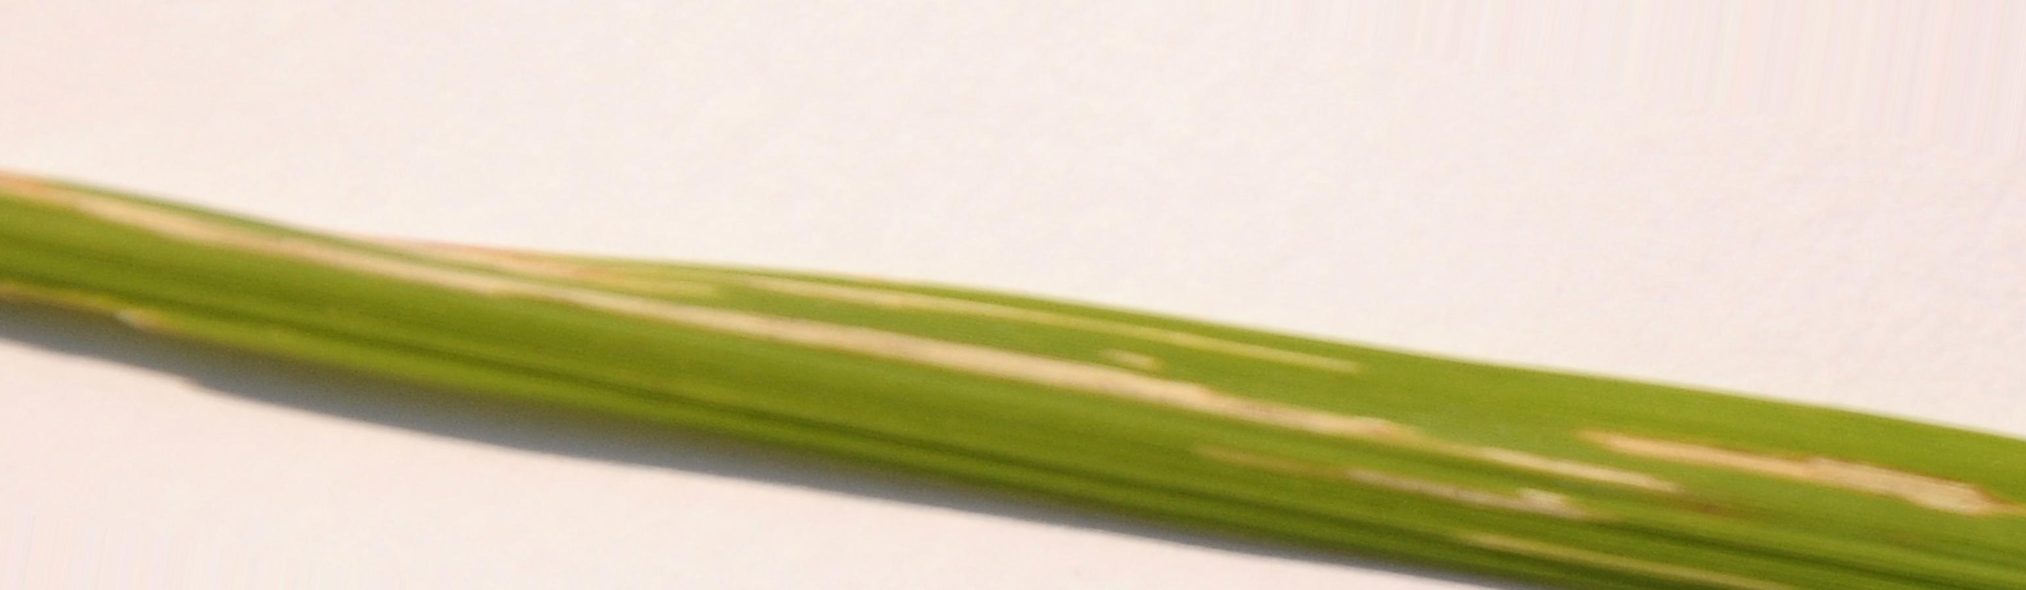
IMPLEMENTATION
There are many paddy leaf diseases but in our project we trained four Leaf diseases to identified they are
BACTERIAL BLIGHT
9
DATE:17/05/2023

Slide 10
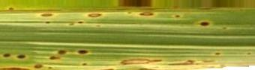
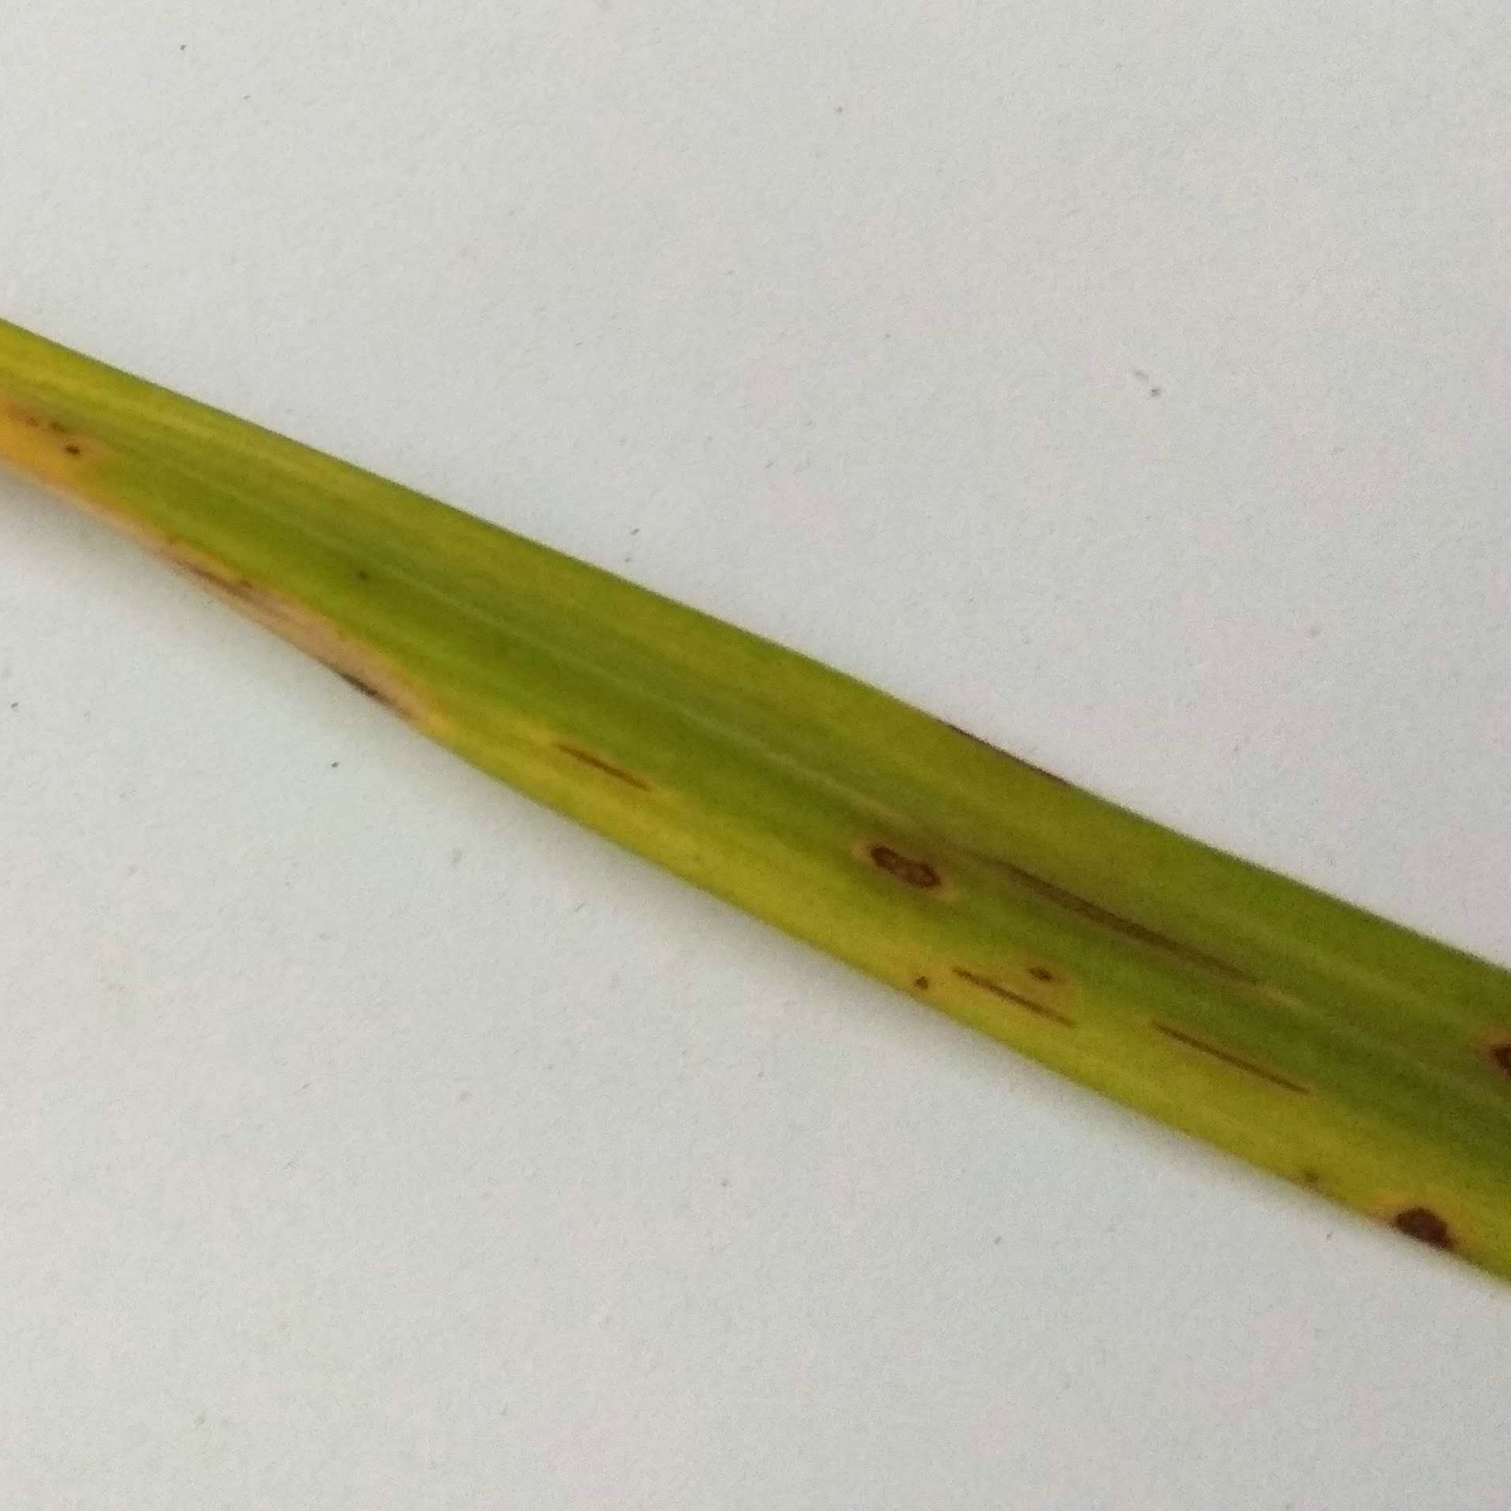
BROWN SPOT
LEAF BLAST
DATE:17/05/2023
10

Slide 11
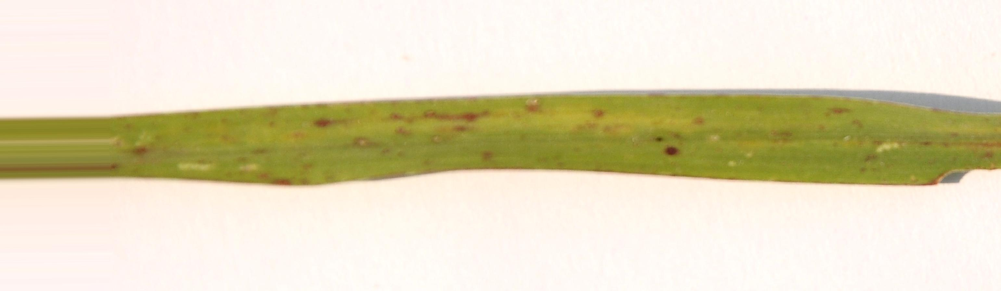
LEAF SMUT
These are the leaf disease we trained for Support Vector Machine (SVM) Algorithm
for Classification. Dataset are Collected from https://www.kaggle.com/
11
DATE:17/05/2023

Slide 12
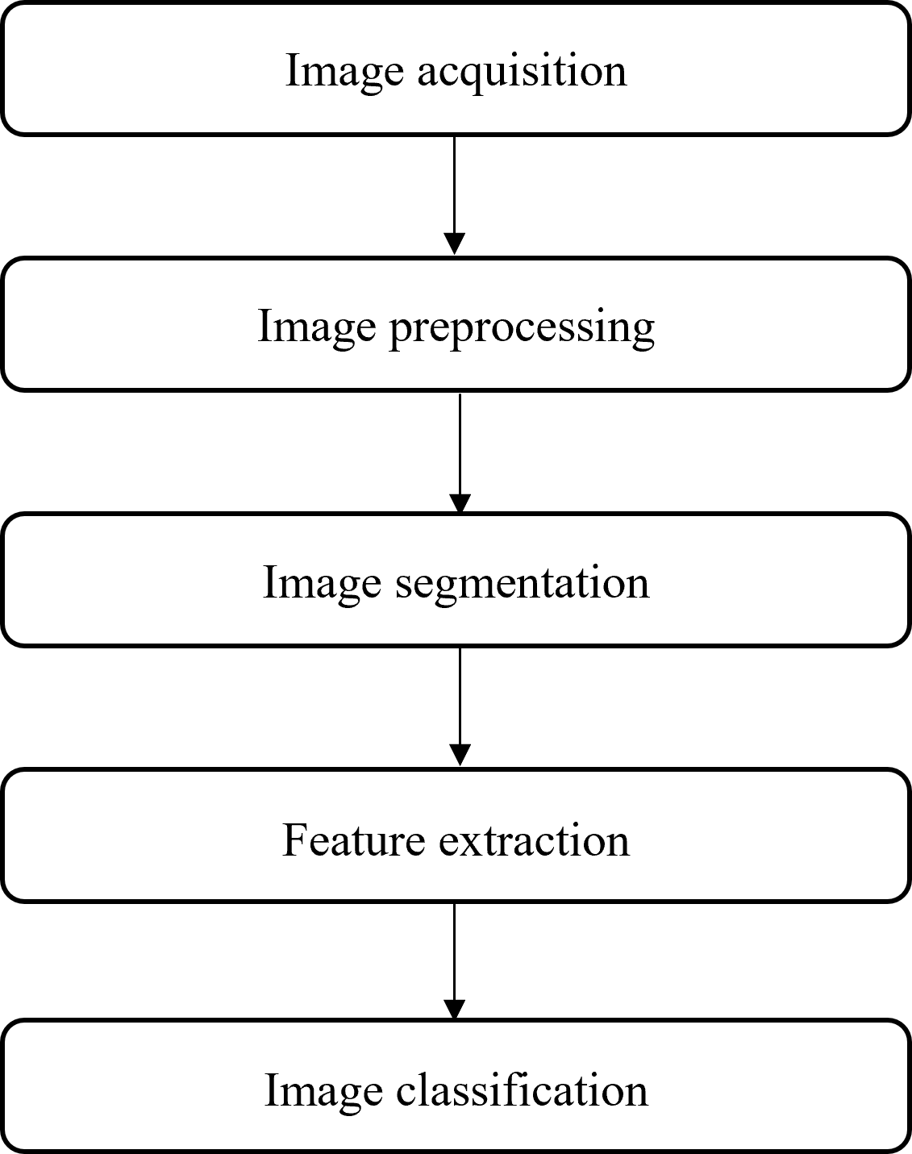
STEPS
DATE:17/05/2023
12

Slide 13
IMAGE ACQUISITION
In this project on paddy leaf disease detection using image processing, the image acquisition process involves capturing high-resolution images of paddy leaves for further analysis,
by creating an image datastore from a folder containing JPEG image files. This allows efficient handling of multiple images.
13
DATE:17/05/2023

Slide 14
IMAGE PRE-PROCESSING
SVM algorithms can be sensitive to the size of input images, so it is often necessary to resize the Paddy Leaf images to a fixed size before training the model. MATLAB provides the "imresize" function for resizing images. The resize of image is 128 x128
14
DATE:17/05/2023

Slide 15
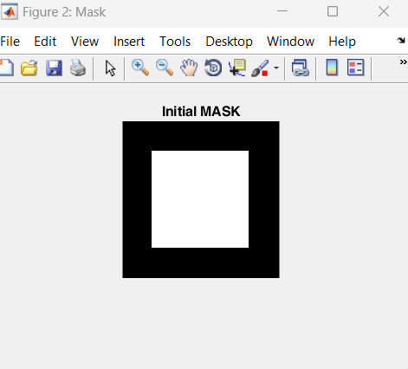
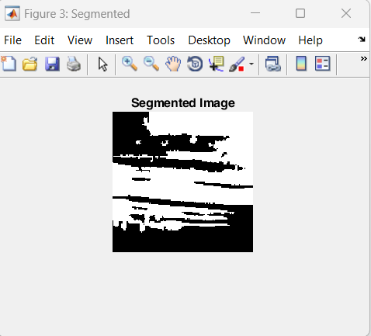
IMAGE SEGMENTATION
It is a process of separating paddy leaf image from its background. From grey level images, thresholding can create binary images by turning all pixels into 0 and 1. Pixels that reach the threshold value are turned to one and below the threshold value turned to zero. Obtaining a binary image in initial stage can reduce data complexity and make detection and classification a simple process. Black pixels refer to background and white pixel refers to foreground
DATE:17/05/2023
15

Slide 16
FEATURE EXTRACTION
Feature extraction refers to the process of transforming raw data into numerical features that can be processed while preserving the information in the original data set of the paddy leaf. It yields better results than applying SVM directly to the raw data.
In Our project we extract 50 feature from the 20 images
16
DATE:17/05/2023

Slide 17
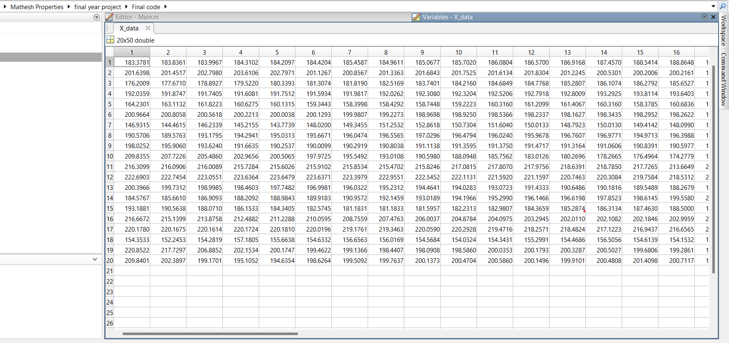
These are the features we extracted from the images to Train the datasets And store in x_data.mat In row represent Images Column represent Features
17
DATE:17/05/2023

Slide 18
SVM CLASSIFICATION
SVM classification was used to classify the paddy leaves as healthy or diseased based on the extracted features. If it is Unhealthy. It is classify and display the disease name in the command window.
We classify Each Diseases with different class with Specific Number And Store In Y_data.mat
18
DATE:17/05/2023

Slide 19
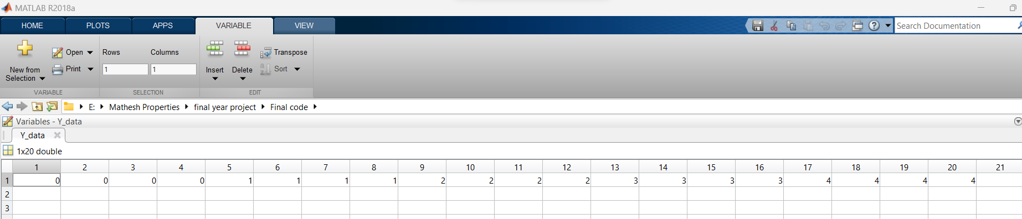
Class 0 Represent the leaf blight Disease
Class 1 Represent Healthy Leaf
Class 2 Represent Brown spot disease
Class 3 Represent Leaf Blast Disease
Class 4 Represent Leaf Smut Disease
19
DATE:17/05/2023

Slide 20
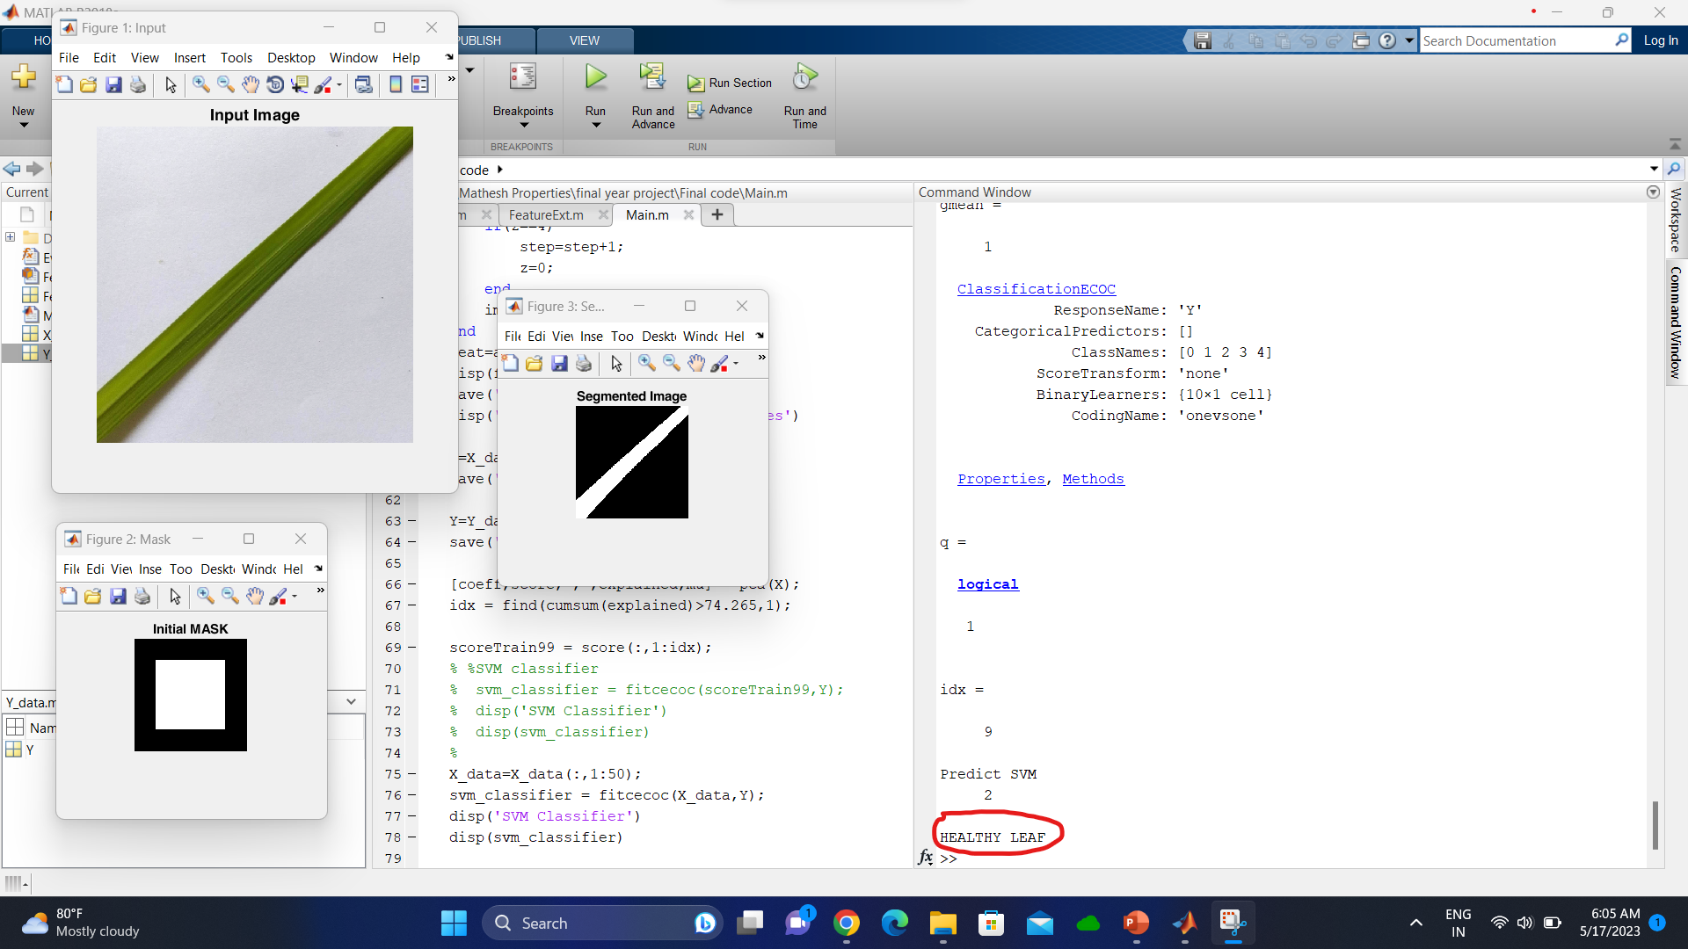
RESULTS
These are the outputs screenshots of our Project
If it is healthy image Displayed as “HEALTHY LEAF” in command window
20
DATE:17/05/2023

Slide 21
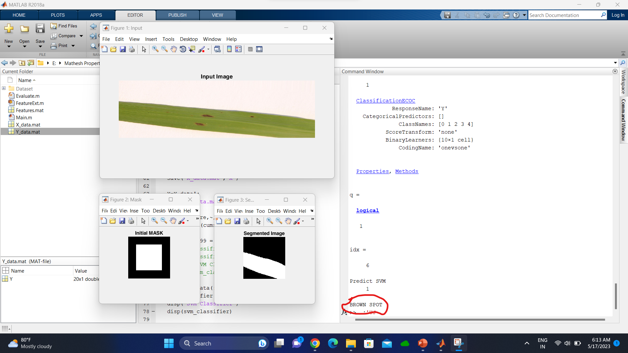
If it is unhealthy It Displayed with its diseases name in command window
21
DATE:17/05/2023

Slide 22
CONCLUSION
Paddy leaf disease detection using image processing has successfully developed a method to identify diseases in paddy leaf images. By utilizing advanced image segmentation techniques, the project has achieved improved accuracy compared to traditional methods. This work has the potential to greatly benefit agriculture by enabling early disease detection and effective management practices, ultimately leading to healthier crops and increased yields.
22
DATE:17/05/2023

Slide 23
FUTURE SCOPE
The future scope of this project includes further refinement and
optimization of the algorithms and models used for paddy leaf disease detection.
Additionally, the system could be expanded to include more types of plant diseases and to work with a wider range of plant species. This would make the system even more useful for researchers and farmers worldwide. Furthermore, the system could be integrated with other agricultural technologies, such as drones or sensors, to provide a more comprehensive and accurate analysis of plant health. Overall, this project lays the groundwork for further advancements in automated plant disease detection and agricultural technology.
23
DATE:17/05/2023

Slide 24
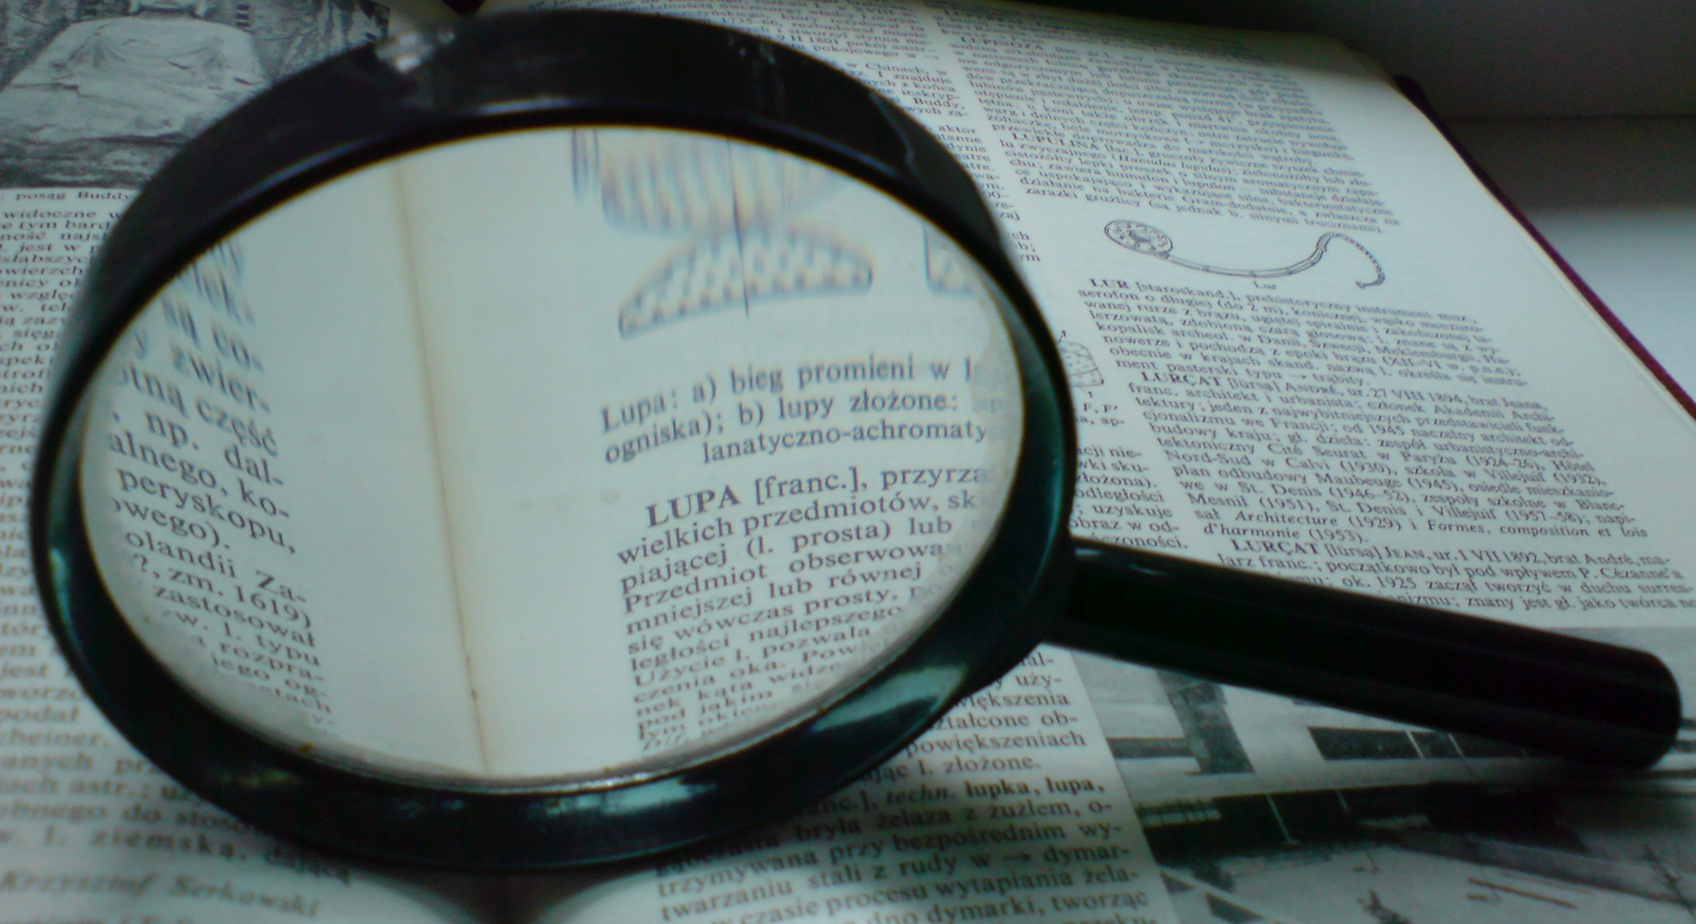
REFERENCE
Amritha Haridasan, Jeena Thomas & Ebin Deni Raj “Deep learning system for paddy plant disease detection and classification” Environmental Monitoring and Assessment volume 195, Article number: 120 (2022).
Pothiyaraj P, Sumathi S. "Automated detection of rice plant diseases using machine learning algorithms." Computers and Electronics in Agriculture 182 (2021): 106021.
Sari S, Mulyana T, Widiastuti I. "Paddy Leaf Disease Identification Using Deep Convolutional Neural Networks." 2020 International Seminar on Application for Technology of Information and Communication (iSemantic). IEEE, 2020
DATE:17/05/2023
24

Slide 25
THANK YOU
DATE:17/05/2023
25

